Slide 1
Blood Bank Management System
R.Logarajah
University of jaffna

Slide 2
Objective
Objective of this project is to maintain the Blood
Bank System. They have to maintain donor details,
Blood component stock details, Screening details,
Component preparation details, Blood request
details, Compatibility details, Blood issue details,
Monthly statistics.

Slide 3
Required Tools
Here we used Microsoft office Access to create
the database and Microsoft Visual Studio .NET
to design the interfaces.

Slide 4
Overview of Presentation
Donor Details
Blood Collection
Screening
Component preparation
Blood storage
Blood request
Compatibility
Blood issue
Monthly statistics

Slide 5
Donor Details
In-house Donations
Blood donors coming to the blood bank for donations
Usually regular blood donors
Mobile Blood Donations
Major part of blood donations
Blood donations can occur in public areas such as Universities , Public libraries, and Associations.

Slide 6
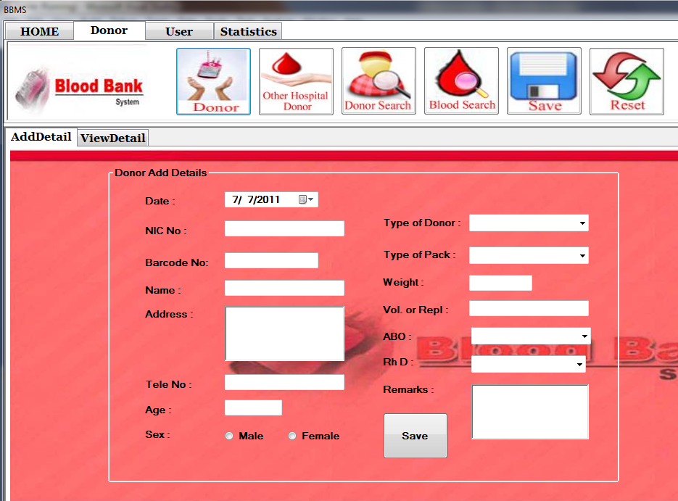
Donor Details Interface

Slide 7
Donor Details
Donor registration should include the following details
NIC number
Barcode number
Name
Donation date.
Addresses.
Gender.
Age.
Type of Donor
Type of Pack
Every donor has a barcode number in each donations. A
barcode number is assigned to a blood pack uniquely.

Slide 8
Cont…
In This Section has following facilities.
Insert to new donor details.
Update to donor details.
Search the donor details, given Barcode No or Type of donor and Date.
Delete donor details by given the Barcode No.

Slide 9
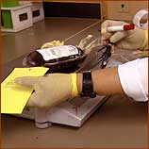
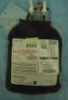
Blood Collection
Blood is collected in different type of packs.
They are double, triple, triple(AS), quadruple
pack.

Slide 10
Screening
In the screening they identify whether the donor’s blood type is A, B, AB, O, or BombayO and the donor’s Rh(D) type is positive or negative.
All donated blood are tested for infections Such as HIV, HepB , HepC, MP, VDRL. The blood is usually discarded if any of these tests are positive.

Slide 11
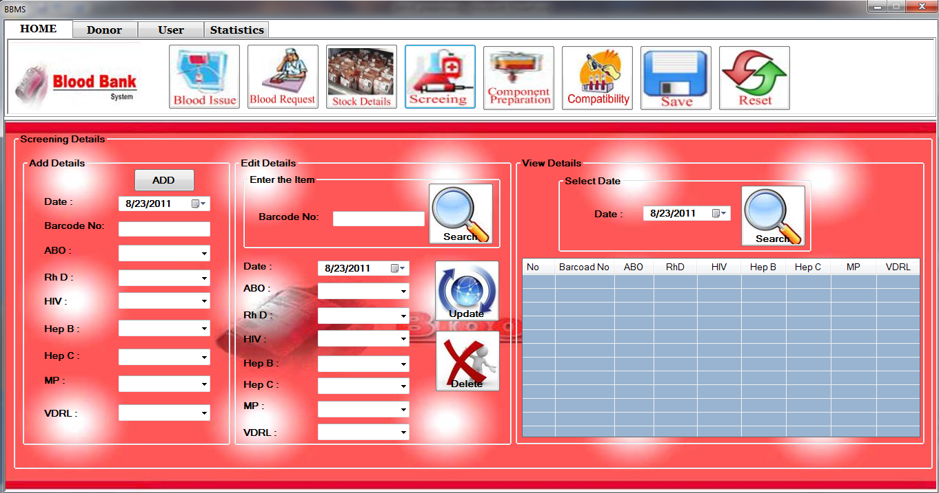
Screening Interface

Slide 12
Cont…
In This Section has facilities.
Insert to components details.
Update to screening details.
Search the screening details, given Barcode No and any one day view the screening details maintains.
Delete donor details, given the Barcode No.

Slide 13
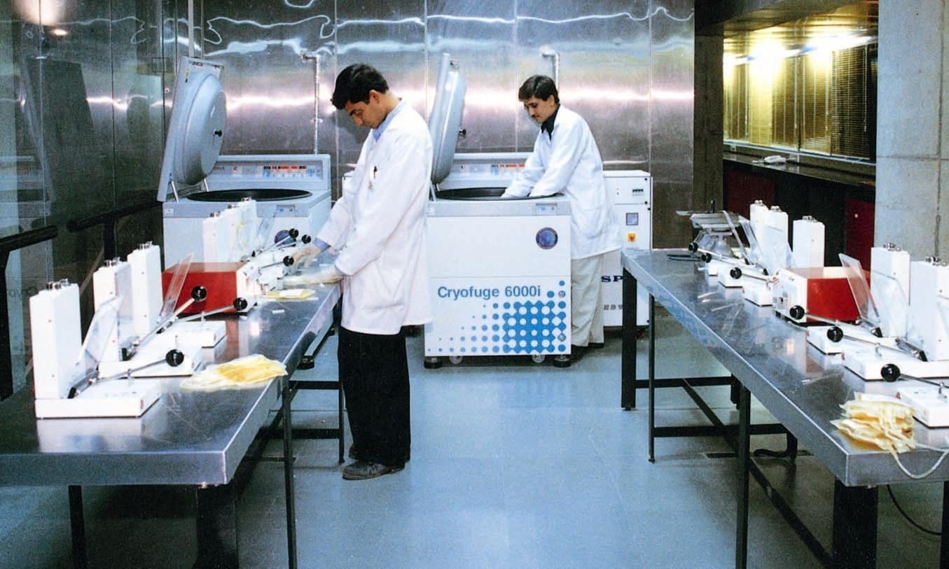
Component preparation
The blood is separated into parts RBC,FFP, and Platelets after the screening.RBC and FFP are separated from all types of packs. Platelets are separated from triple(AS) and quadruple packs only.
The components CPP and Cryo separated from FFP when they need.

Slide 14
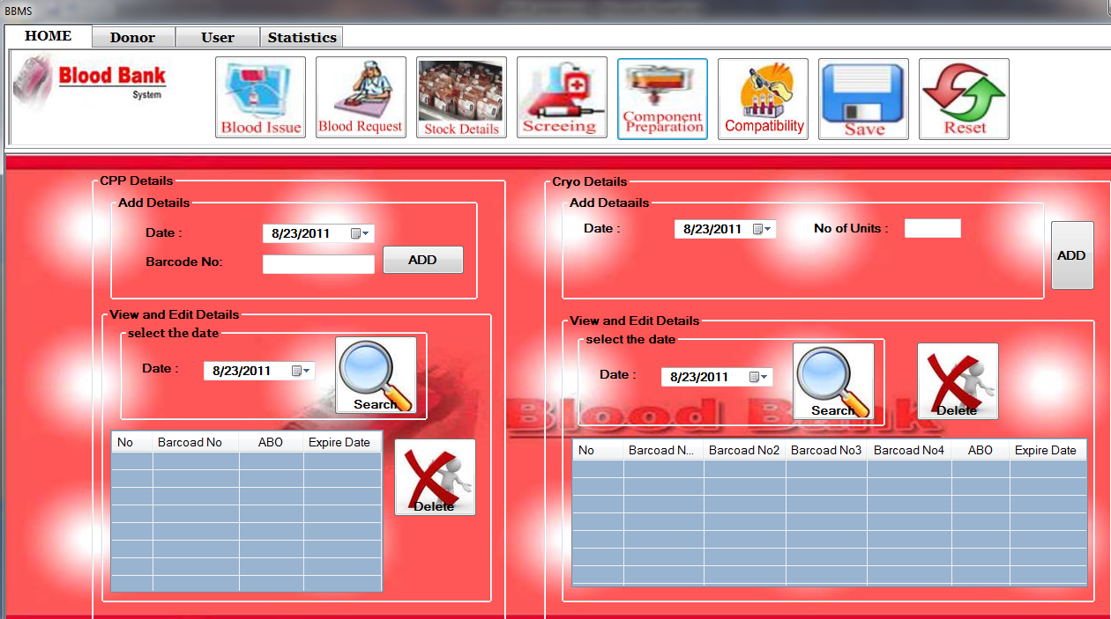
Component preparation interface

Slide 15
Cont…
This Section has following facilities.
Insert the cpp details and cryo details
Search the cpp details and cryo details by given Date and everyday details maintains.
Delete component(cpp,cryo) details.

Slide 16
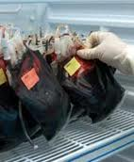
Blood storage
If the pack is double or triple, RBC component will be expired within 35 days from date of collection. If the pack is triple(AS) or quadruple, RBC component will be expired with in 42 days from date of collection.
Platelets will be expired within 5 days and FFP, CPP, Cryo will be expired within one year from the date of collection.

Slide 17
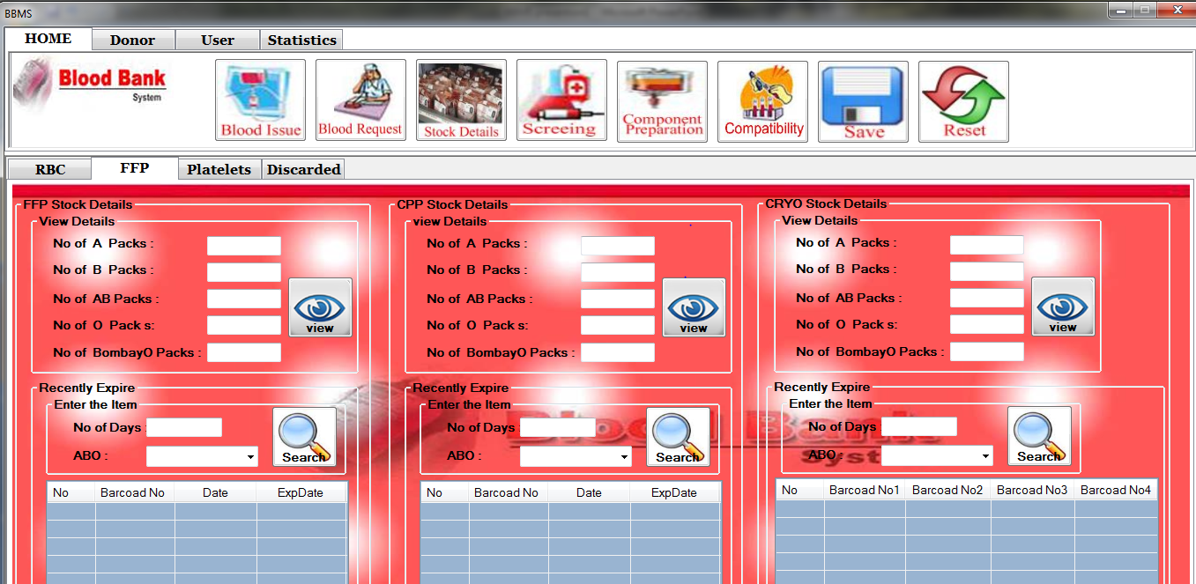
Blood storage interface

Slide 18
Cont….
This Section has facilities.
Insert the discarded details
Search, edit and delete discarded components .
Search the RBC , Platelets stock details and recently expire details by given No of days, ABC and Rhd.
Search the FFP stock details(CPP,CRYO) and recently expired details by given No of days and ABC.

Slide 19
Blood request
Requests for the blood components are received from patients. With the request they bring the blood sample of the patient.
Requests can be received from other hospital for their stock requirements.

Slide 20
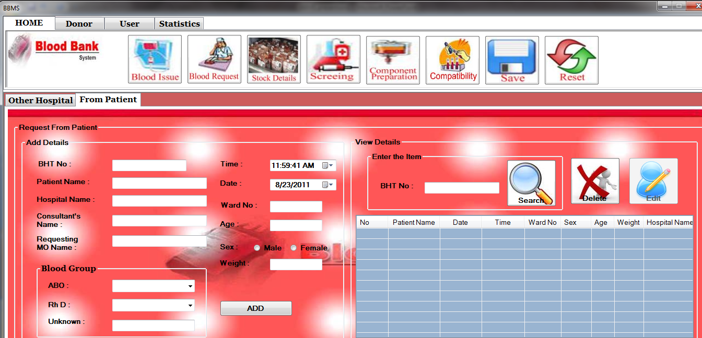
Blood request interface

Slide 21
Cont….
This Section has facilities.
Insert the other hospital blood details and request patient details.
Search the other hospital blood details by given hospital name , patient details by given BHT No.
Delete and Edit the other hospital blood details by given hospital name and date. And patient details BHI No.

Slide 22
Compatibility Testing
Before a transfusion, compatibility testing between donor’s and patient’s blood must be done. Firstly they perform testing to determine the blood type of patients and perform cross matching test to identify compatible blood components for blood transfusions.

Slide 23
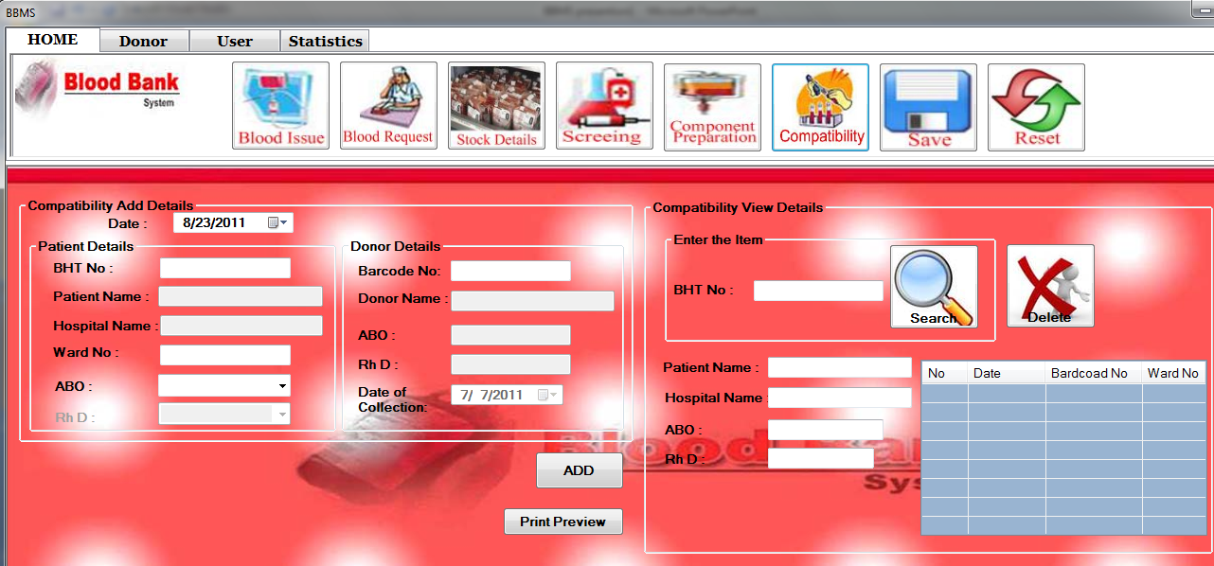
Compatibility testing interface

Slide 24
Cont….
This Section has facilities.
Insert the compatibility details and print preview.
Search the compatibility details given BHT No.
Delete compatibility details given BHI No.

Slide 25
Blood issued
They issue the components to the patient according the compatibility report.
To other hospitals they issue RBC only.

Slide 26
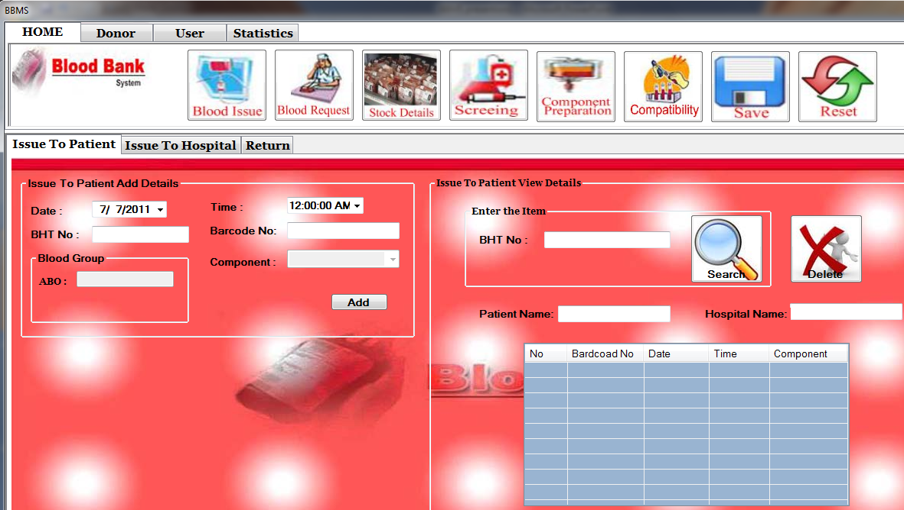
Blood issue interface

Slide 27
Cont….
This Section has facilities.
Insert the issue to patient, other hospital and return blood details.
Search the patient details by given BHT No , other hospitals details given hospital name and date, and return details by given date.
Delete the other hospital blood details by given hospital name and date, patient details by given BHI No, And return details given date.

Slide 28
Monthly Statistics Analysis
The following Statistical Analysis are maintained by the Hospital Blood Bank.
Blood Collection
Blood Collection Of Summary
Collection Of Blood Group
Analysis Of RCC

Slide 29
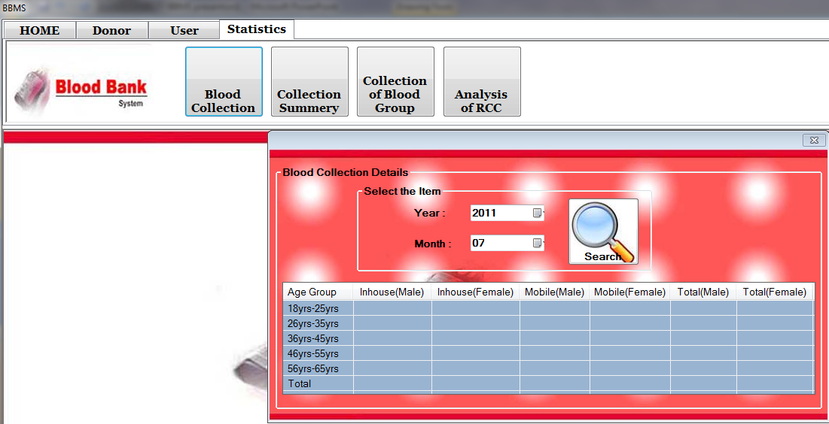
Monthly statistics analysis interface

Slide 30
Cont….
This Section has following facilities.
Search the blood collection donors ages group details given Year and month.
Search the blood collection summery donors details given Year and month.
Search the collection of blood groups details given Year and month.
Search the analysis of RCC details given Year and month.

Slide 31
Conclusion
As the donor’s data is saved in the system we can reject those who have HIV or any other infections.
As we have the contact number of the donor
we can contact donor whenever necessary comes.
Since we have the expiry date of the packs we can have a proper storage management system.

Slide 32
Future Works
This system will be linked by internet, so the other hospitals can use this data.
Now we intended to draw graph and print monthly statistical analysis details and to take backup database in another computer. We decided to change the database to SQL server from Microsoft Access.

Slide 33
THANK YOU

